Slide 1
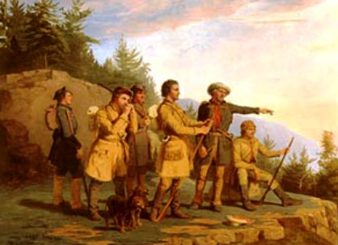
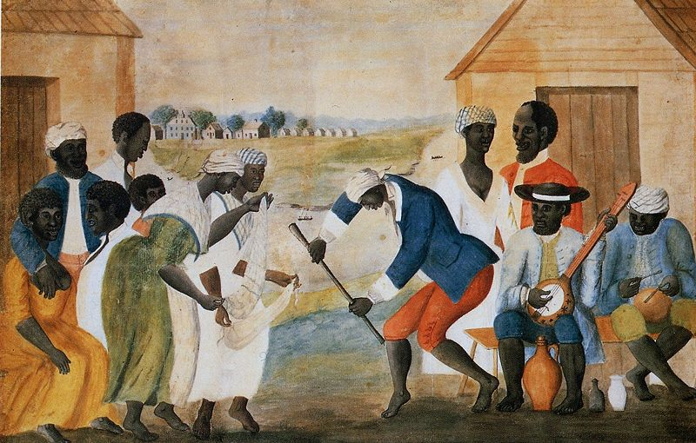
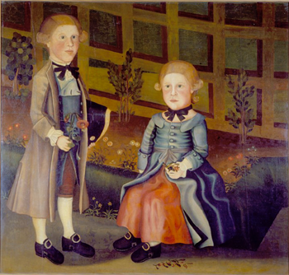
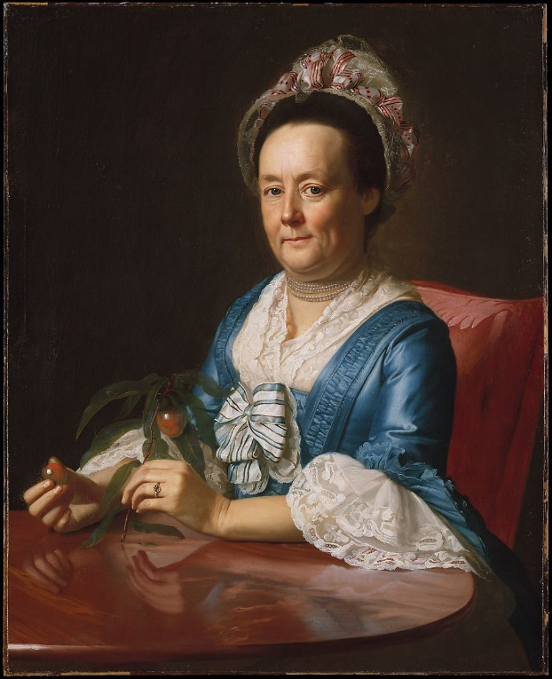
Culture in the 13 Colonies

Slide 2
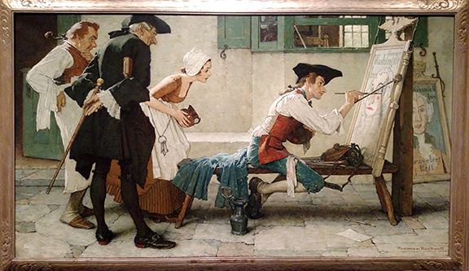
The Arts

Slide 3
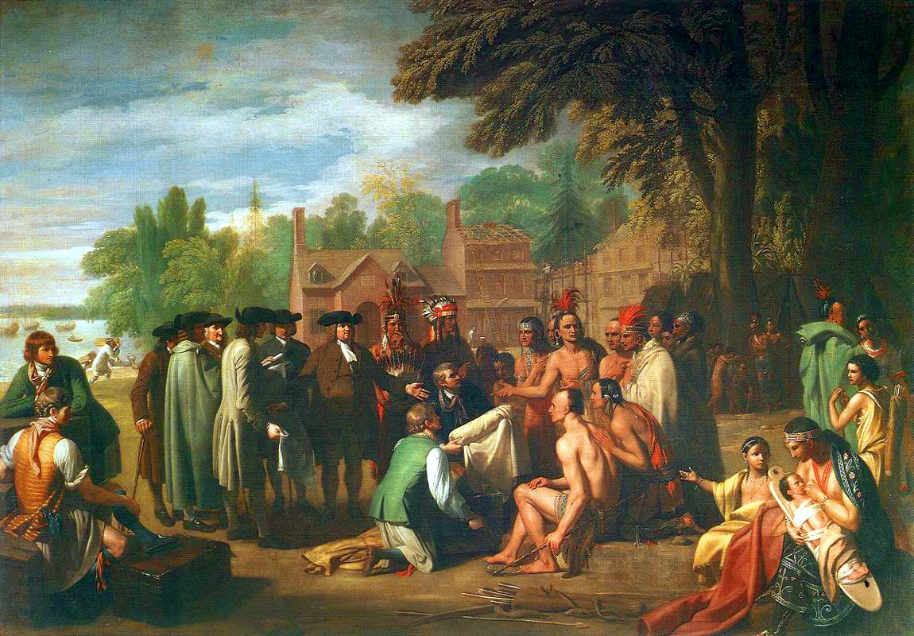
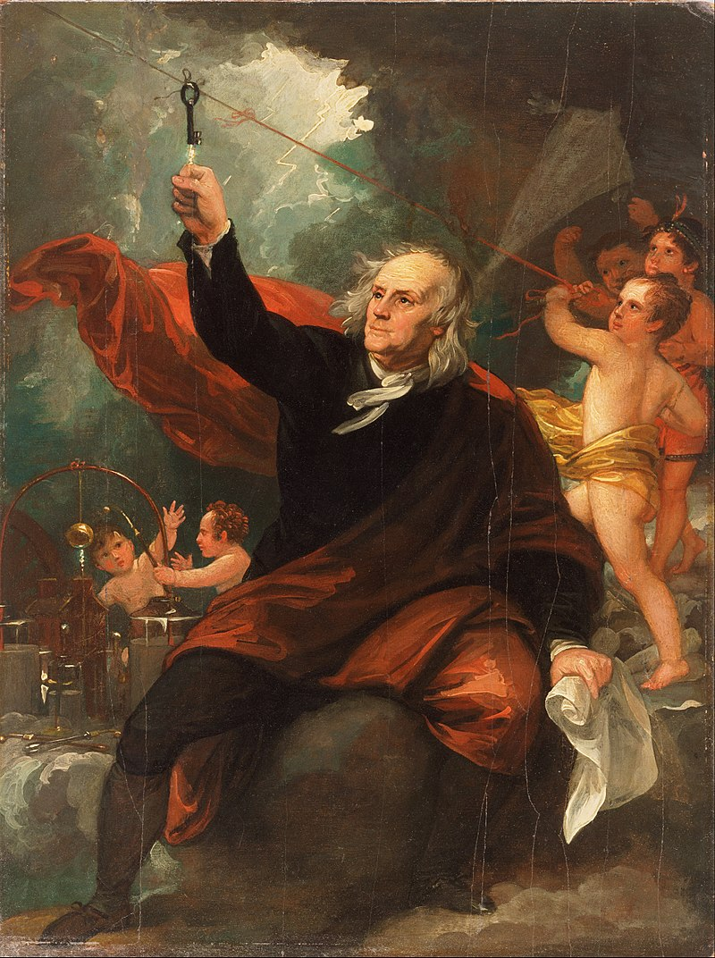
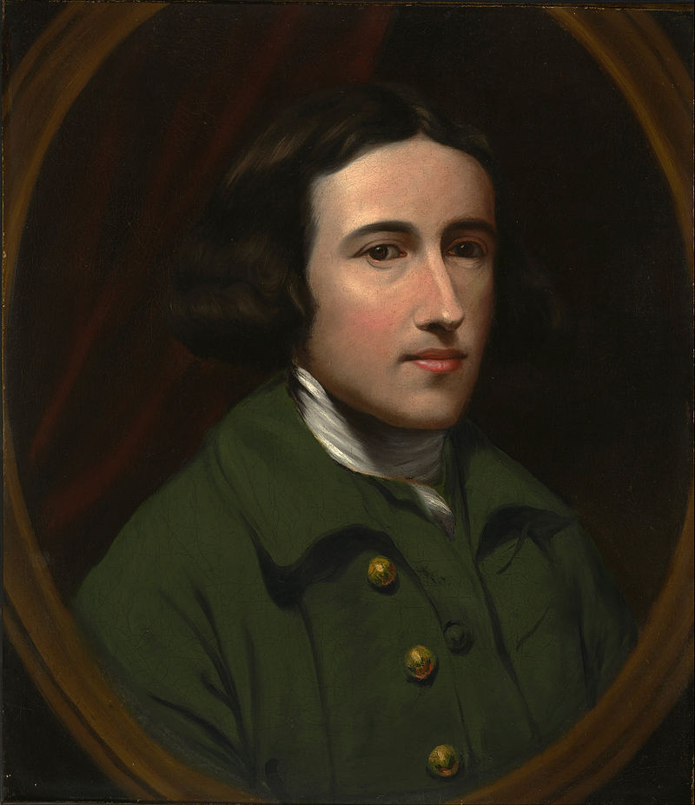
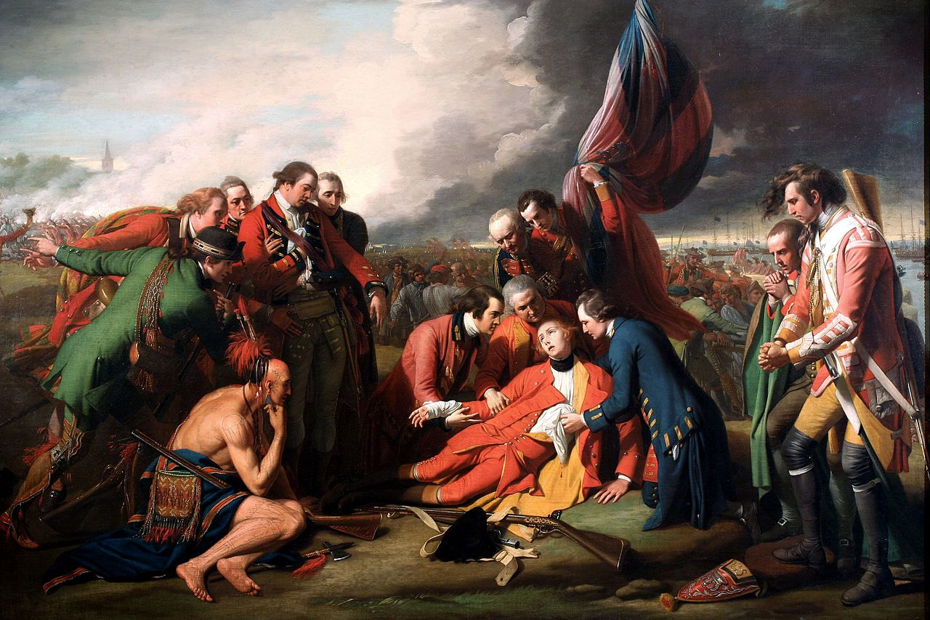
Benjamin West
American-born painter
Became famous in London
Benjamin West

Slide 4
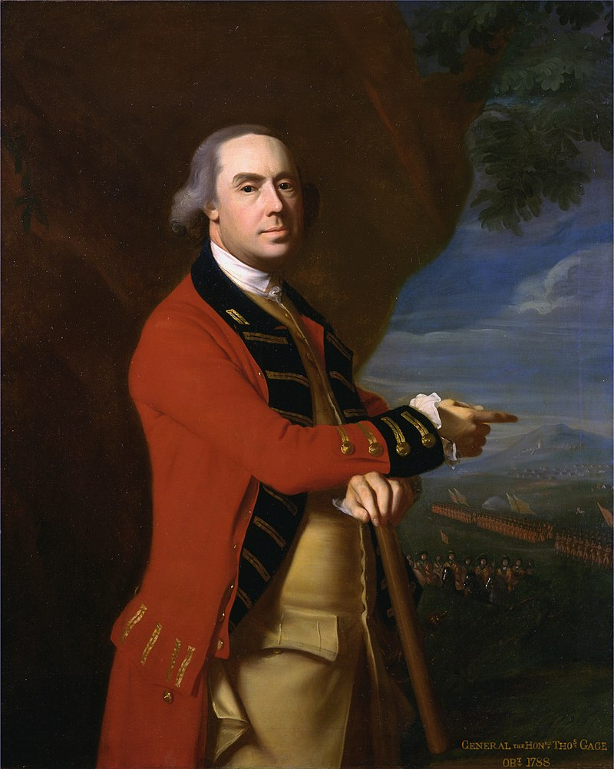
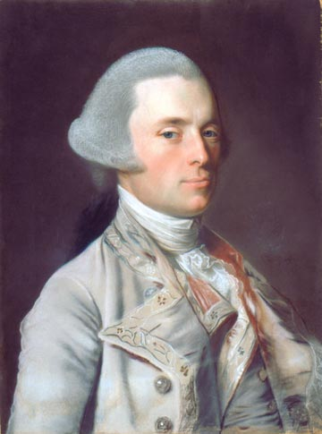
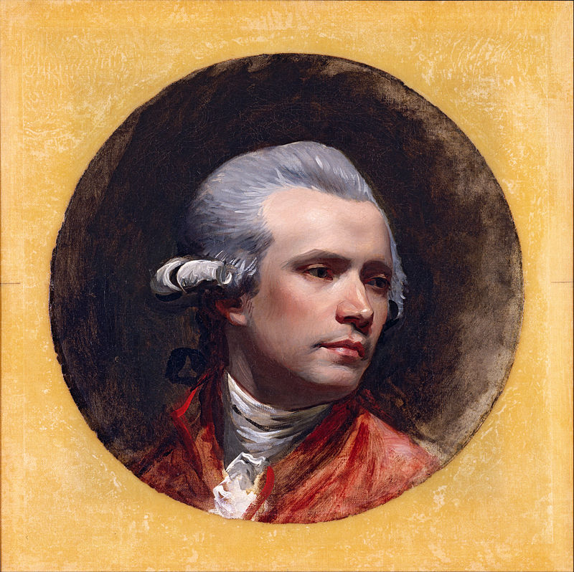
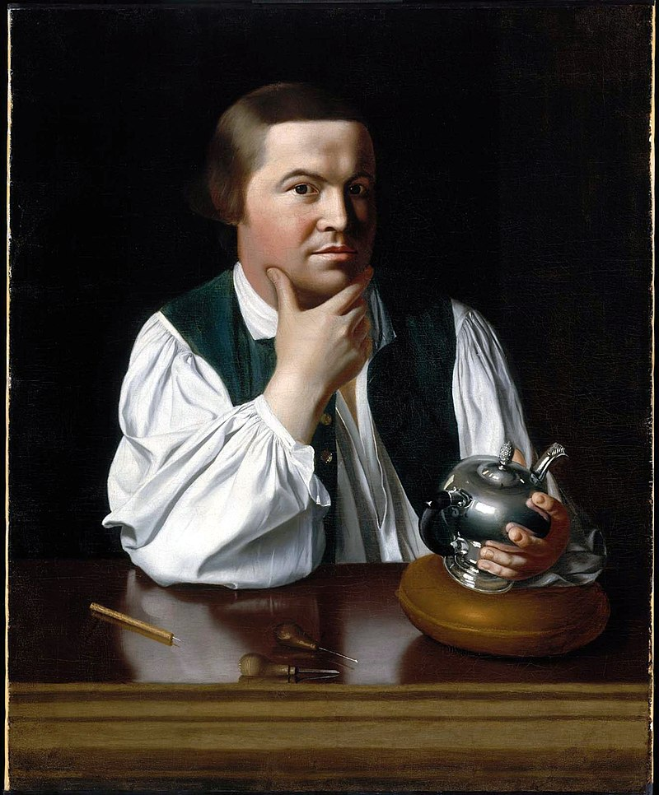
John Copley
American-born artist
Became famous in London
John Singleton Copley

Slide 5
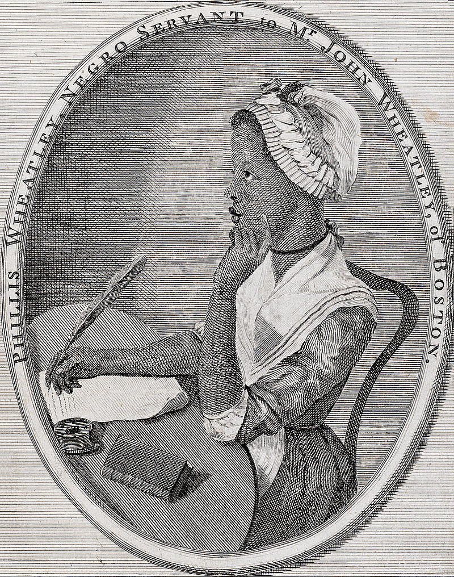
Phillis Wheatley
African-American Poet
On being brought from Africa to America
Twas mercy brought me from my Pagan land, Taught my benighted soul to understand That there's a God, that there's a Saviour too: Once I redemption neither sought nor knew. Some view our sable race with scornful eye, "Their colour is a diabolic dye." Remember, Christians, Negroes, black as Cain, May be refin'd, and join th' angelic train.

Slide 6
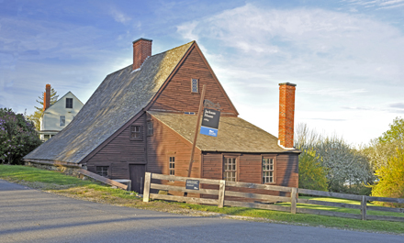
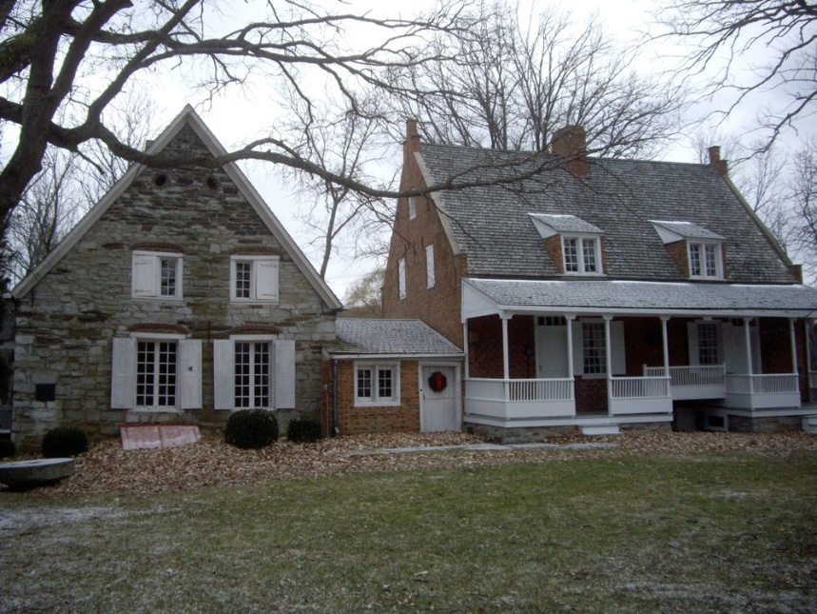
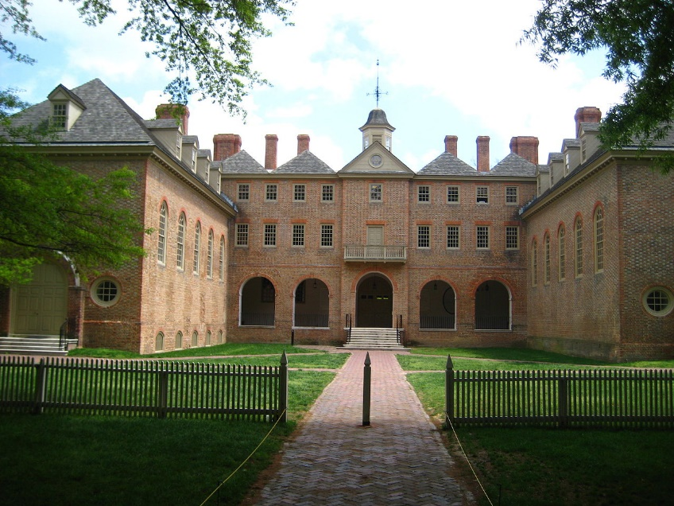
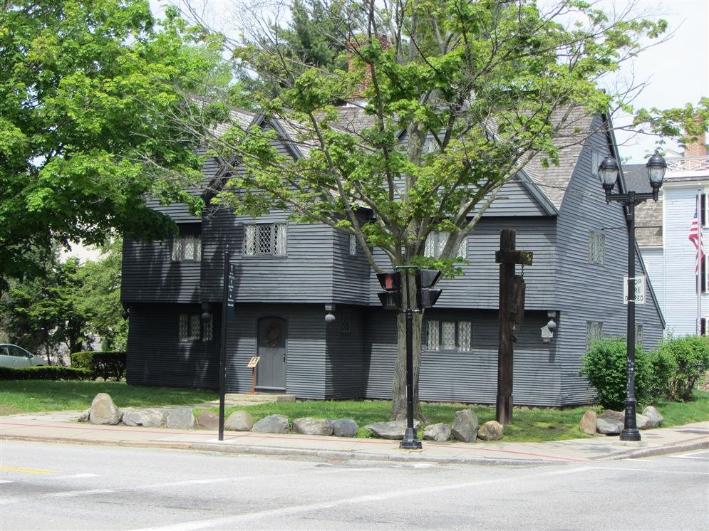
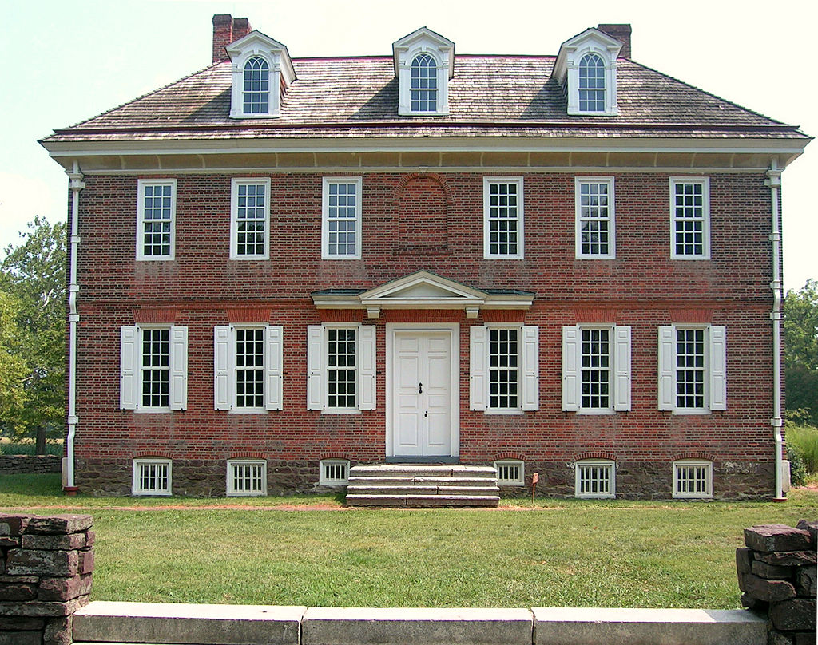
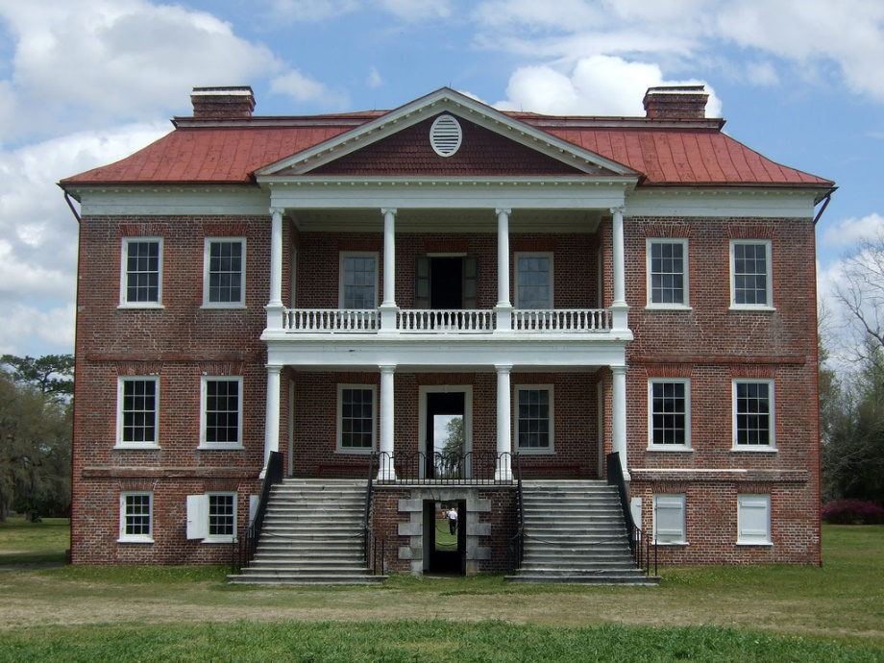
Architecture

Slide 7
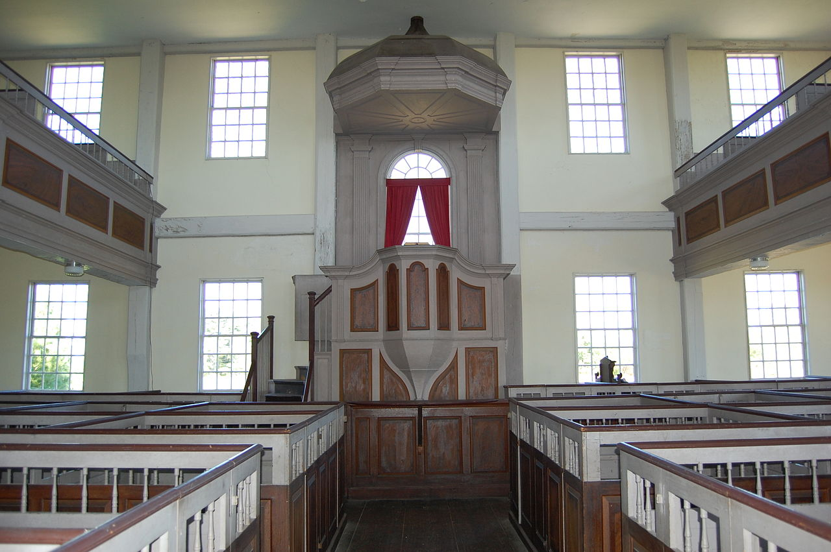
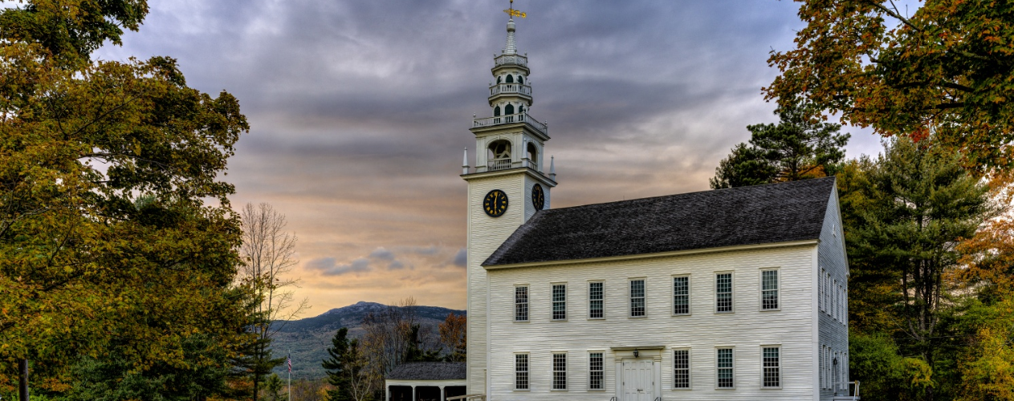
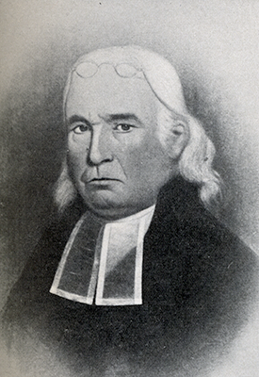
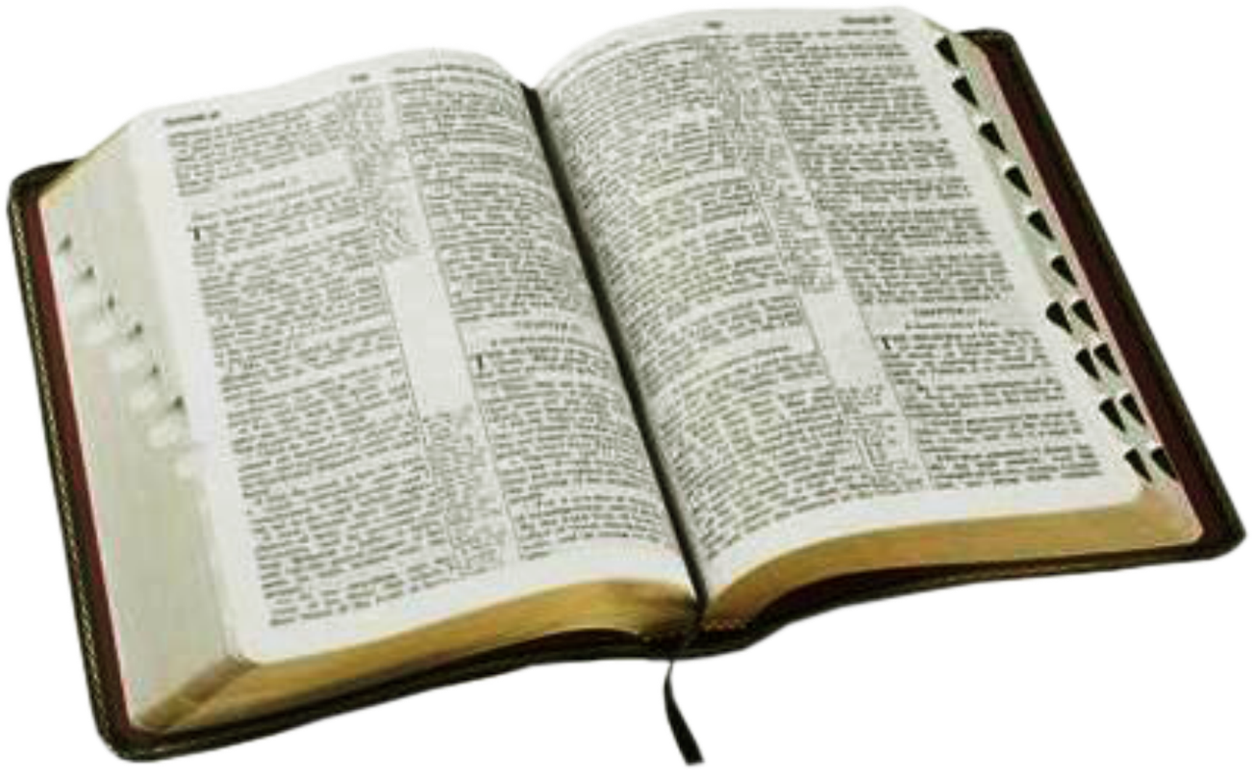
Religion

Slide 8
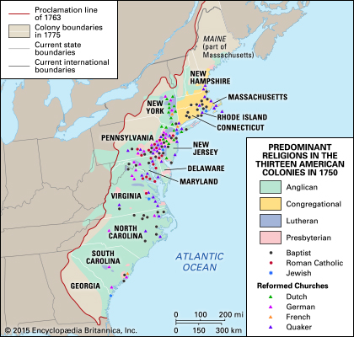

Slide 9
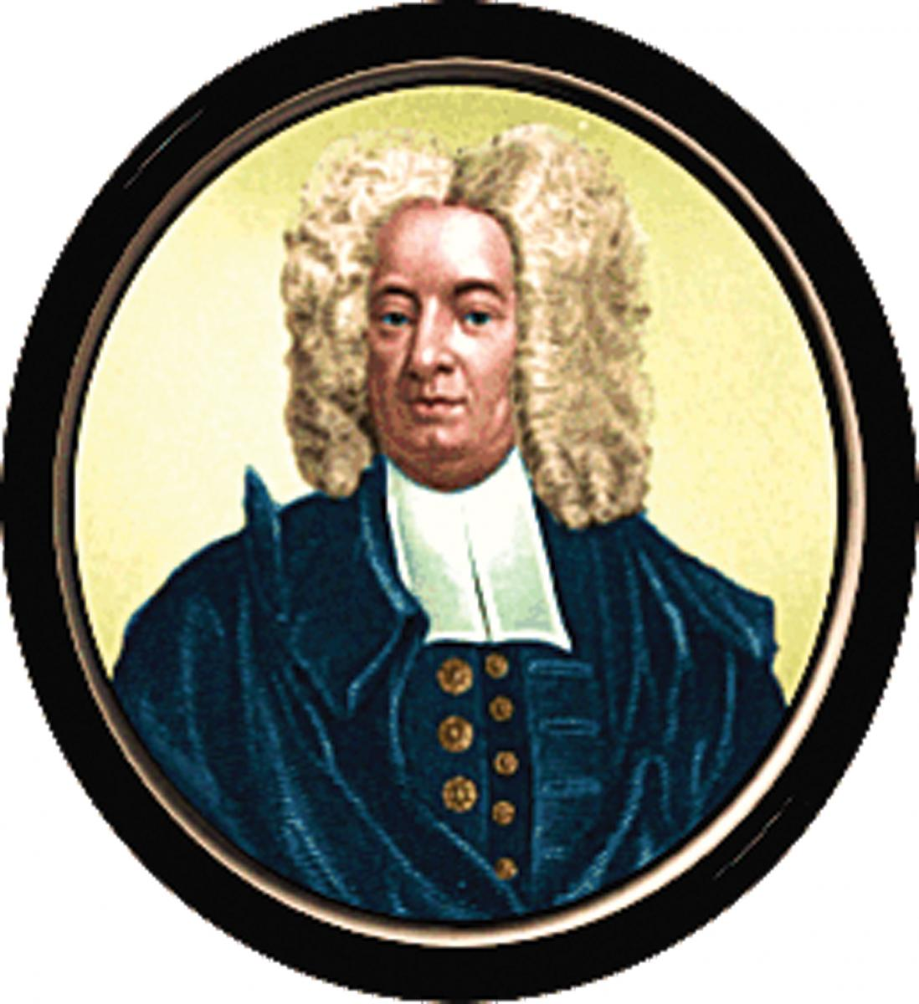
Cotton Mather
Puritan Minister from Massachusetts
Involved in the Salem Witch Trials
Prolific writer and defender of Puritan values
“The New-Englanders are a People of God settled in those, which were once the Devil's Territories; and it may easily be supposed that the Devil was exceedingly disturbed, when he perceived such a People here accomplishing the Promise of old made unto our Blessed Jesus, That He should have the Utmost parts of the Earth for his Possession.”

Slide 10
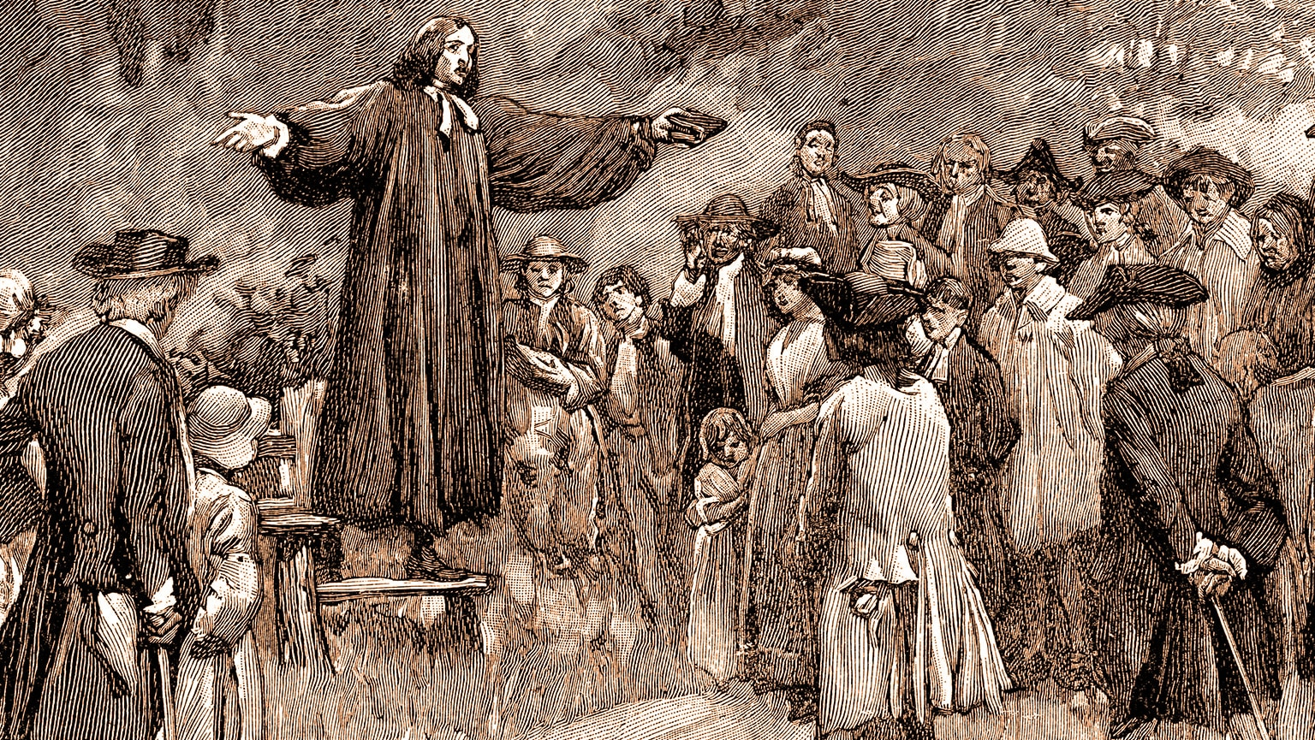
The Great Awakening
Dramatic revival of religion in the colonies in the 1730s and 1740s
Fervent, energetic expressions of religious belief
Very emotional and personal
“Democratized religion”

Slide 11
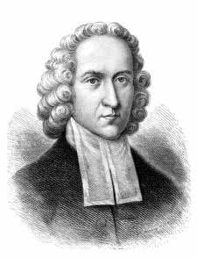
Jonathan Edwards
“The bow of God's wrath is bent, and the arrow made ready on the string, and justice bends the arrow at your heart, and strains the bow, and it is nothing but the mere pleasure of God, and that of an angry God, without any promise or obligation at all, that keeps the arrow one moment from being made drunk with your blood.”
Congregationalist minster from Massachusetts
Argued that sinners must repent to be saved, and those who don’t will be damned.
From Sinners in the Hands of an Angry God

Slide 12
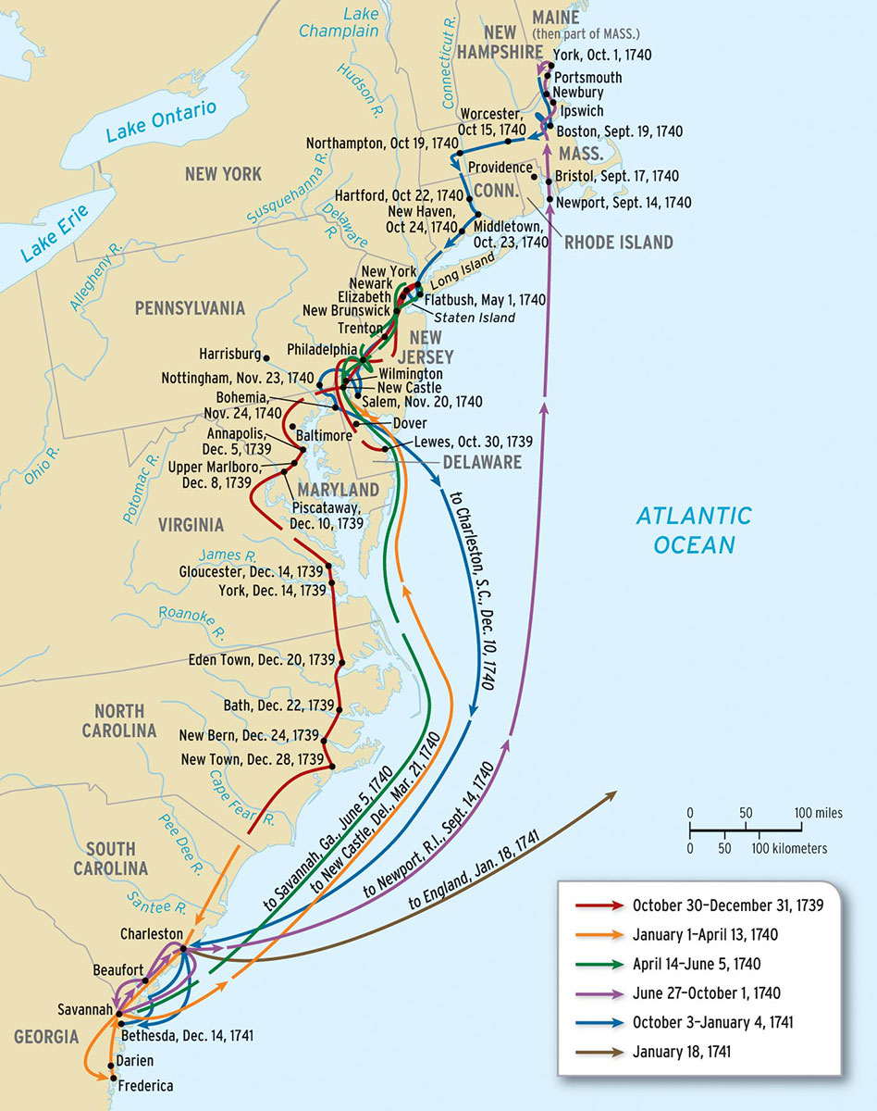
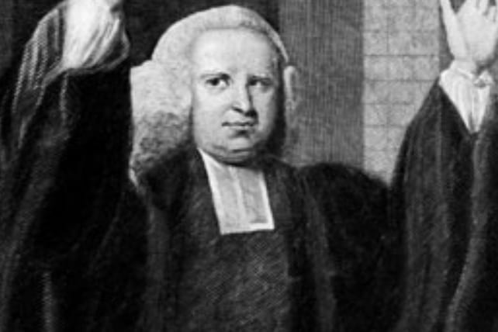
George Whitefield
English preacher who traveled across America, giving sermons at mass gatherings
Preached that sinners could be saved through openly professing their faith in God
"Hark! Methinks I hear [the saints] chanting their everlasting hallelujahs, and spending an eternal day in echoing forth triumphant songs of joy. And do you not long, my brethren, to join this heavenly choir?“
-Rev. George Whitefield

Slide 13
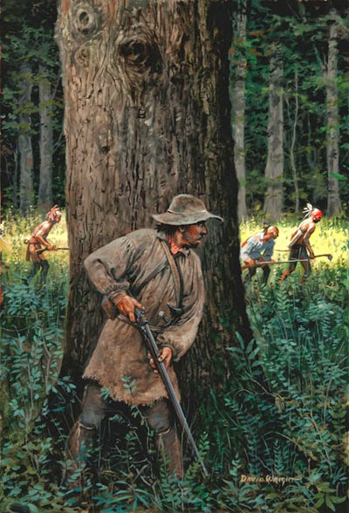
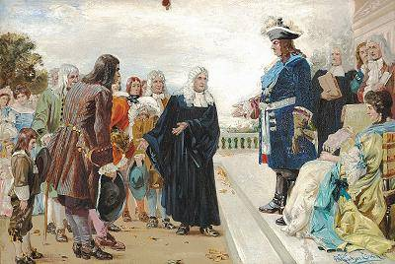
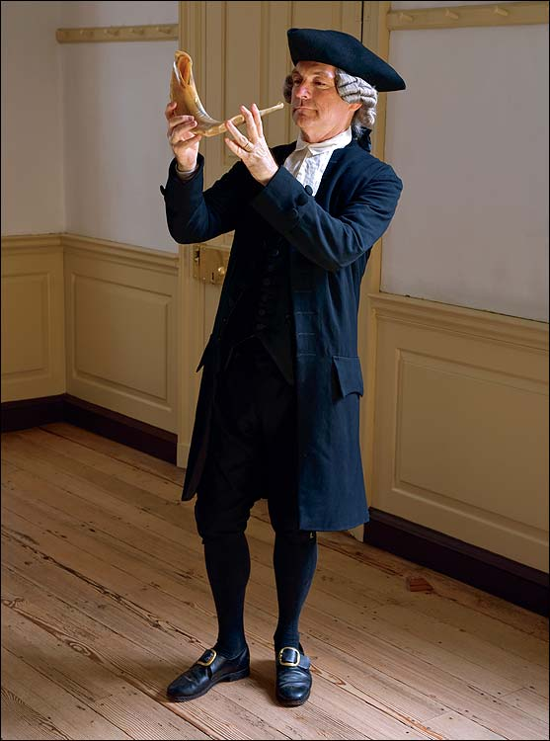
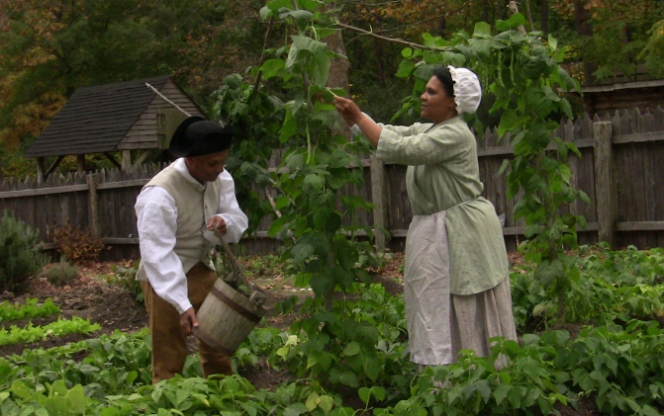
Ethnic Groups

Slide 14
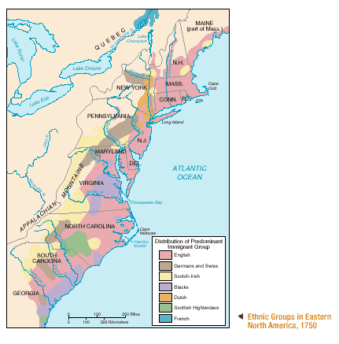

Slide 15
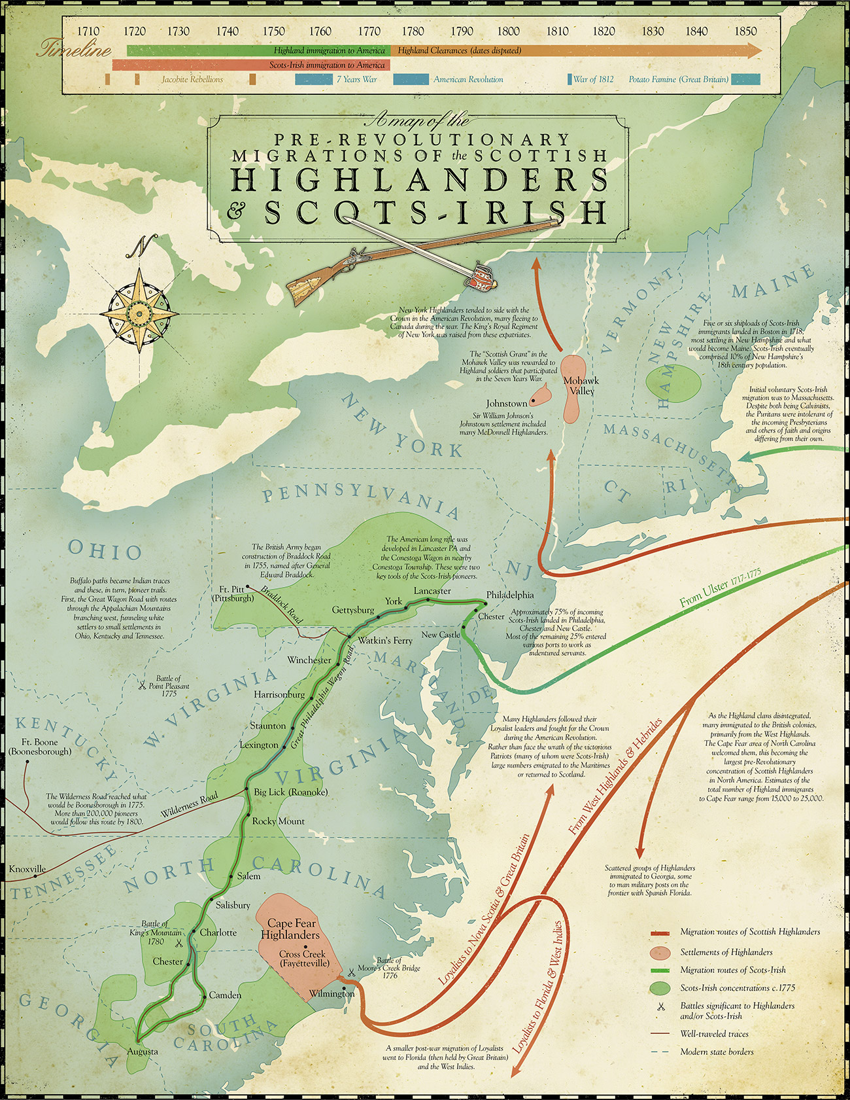
Scots Irish
Settlers who left Scotland for Ireland, then for America
Mostly poor, often illiterate
Settled in “The Backcountry” of Pennsylvania, Virginia, the Carolinas, and northern New England
Used to fighting for land and often fought with Native Americans

Slide 16
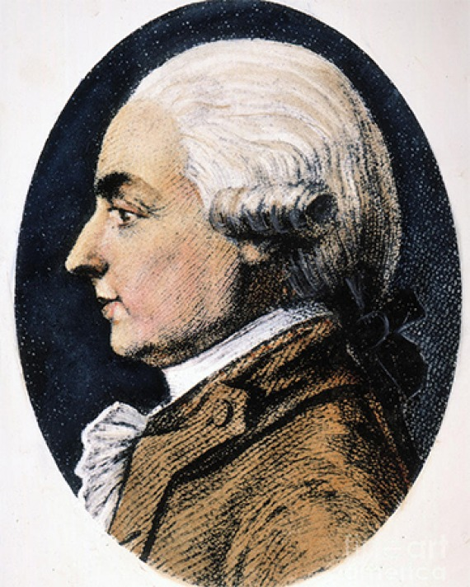
Hector St. John Crevecoeur
“What then is the American, this new man? He is either a European or a descendant of a European; hence that strange mixture of blood, which you will find in no other country. I could point out to you a family whose grandfather was an Englishman, whose wife was Dutch, whose son married a French woman, and whose present four sons have now four wives of different nations. He is an American who, leaving behind him all his ancient prejudices and manners, receives new ones from the new mode of life he has embraced, the new government he obeys, the new rank he holds.” – Hector St. John Crevecoeur
French immigrant who settled in America
Wrote “Letters from an American Farmer” which described an ideal, beautiful America filled with hard working people, no aristocracy or intolerance.

Slide 17
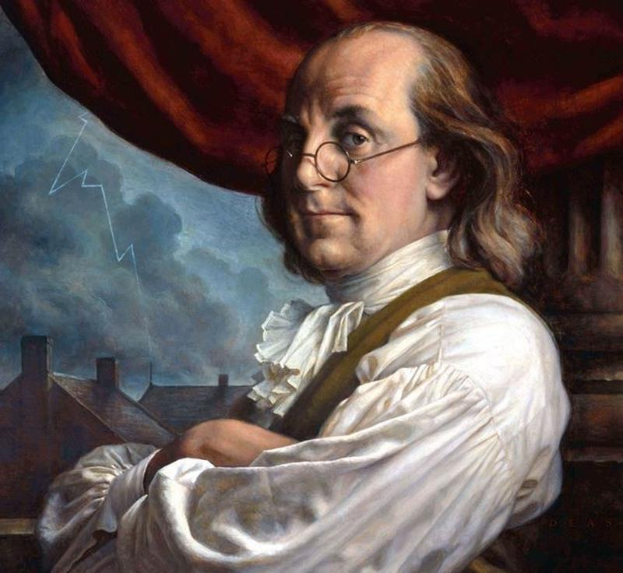
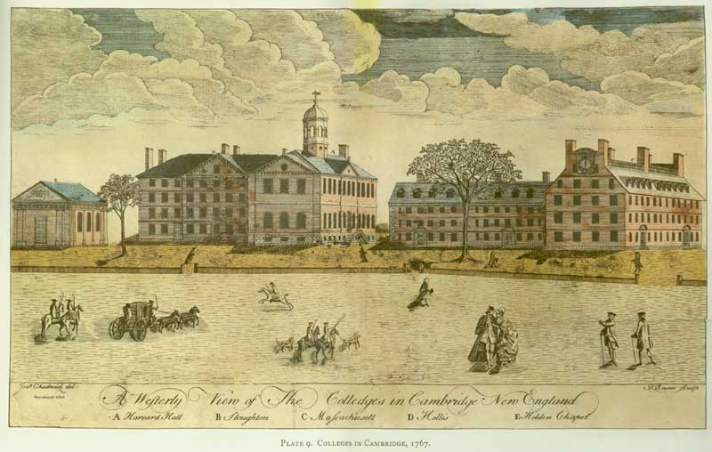
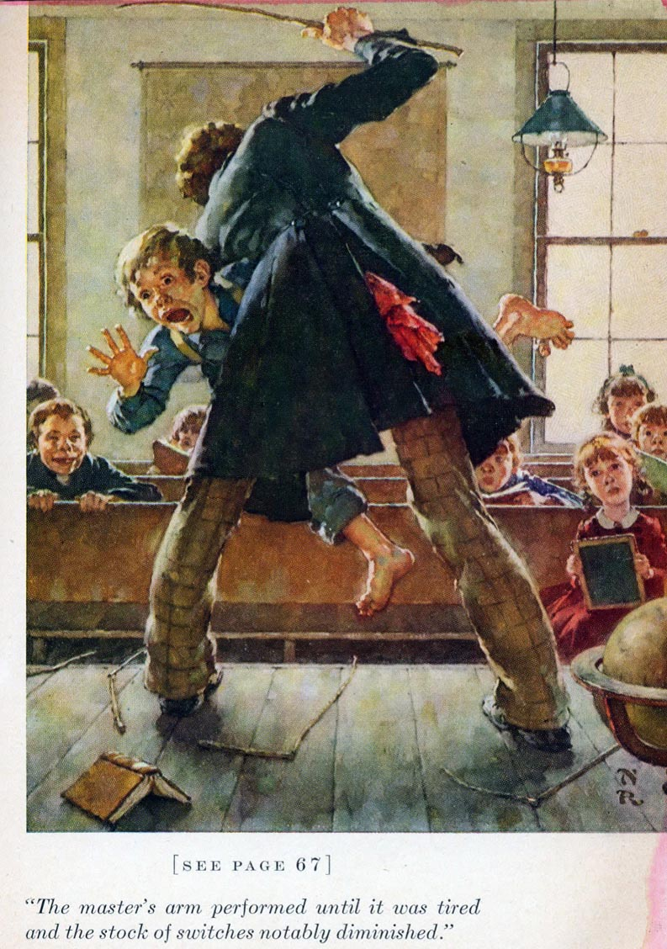
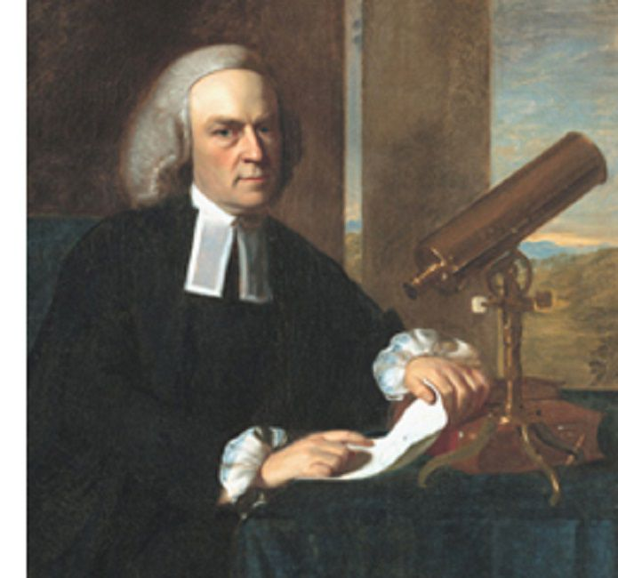
The Sciences & Education

Slide 18
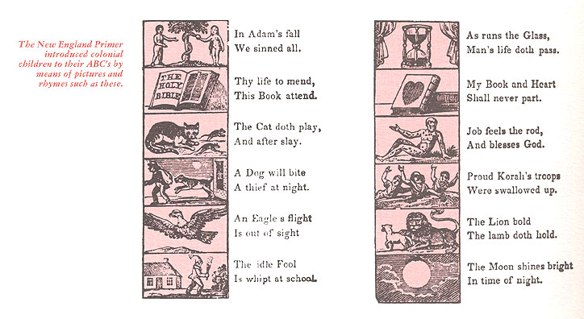
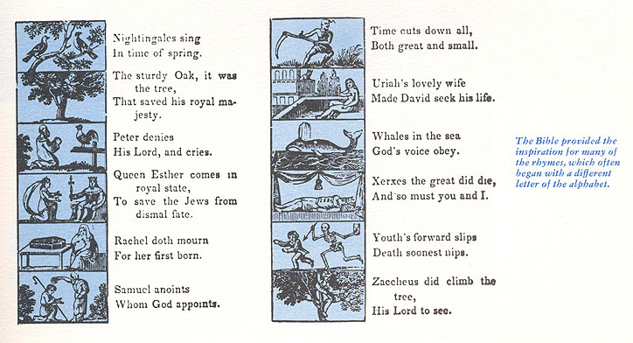
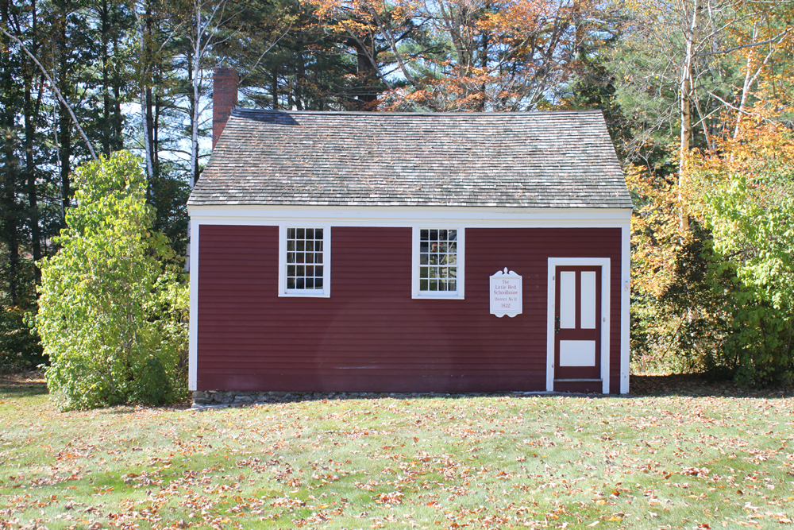
Colonial Schools
New England: Public schools started here in 1635 (Boston Latin School) and towns were required to support them. Education lasted through elementary school. Boys could continue at academies to prepare for college, girls would learn writing and math, then continue studies at home.

Slide 19
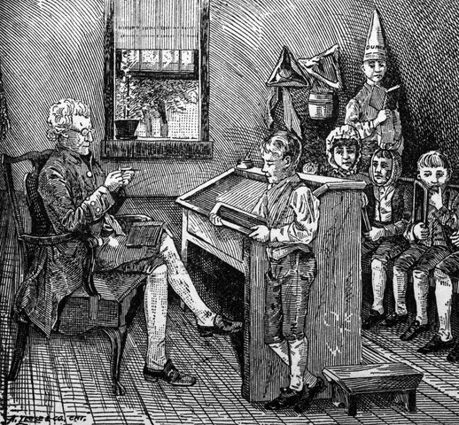
Colonial Schools
Middle Colonies: Churches often ran schools, and there were private schools by tuition.
Southern Colonies: Children on plantations were often privately tutored. Enslaved children received no education.

Slide 20
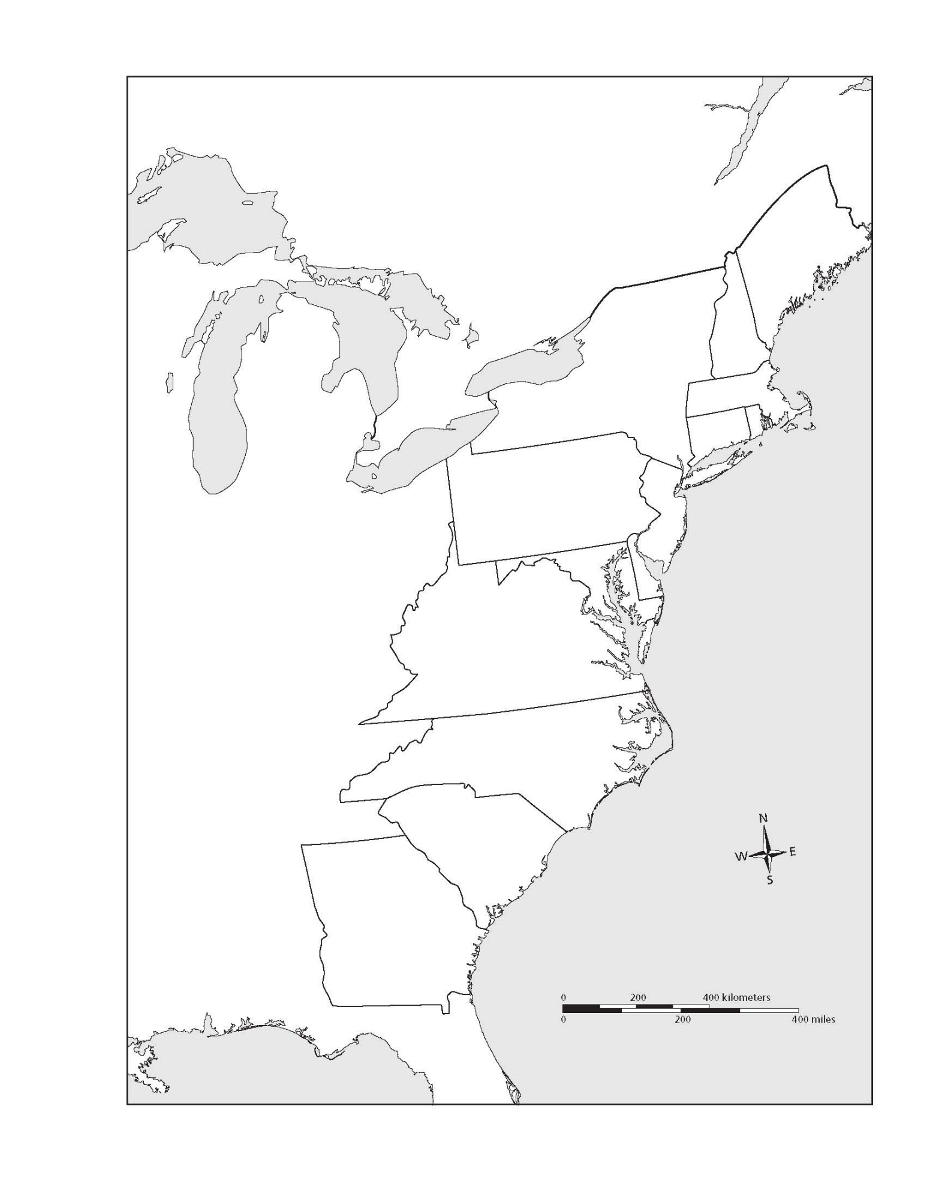
Colonial Colleges
Harvard, Massachusetts (Puritan) 1636
William & Mary, Virginia (Anglican) 1694
Yale, Connecticut (Congregationalist) 1701
Princeton, New Jersey (Presbyterian) 1746
Columbia, New York (Anglican) 1754
Brown, Rhode Island (Baptist) 1764
Rutgers, New Jersey (Dutch Reformed) 1766
University of Pennsylvania (Secular) 1765
Dartmouth, New Hampshire (Congregationalist) 1769
These trained men to become doctors, lawyers, or ministers

Slide 21
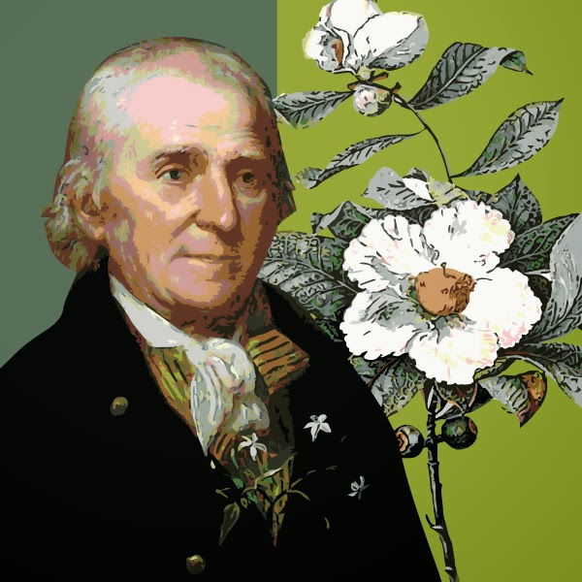
John Bartram
Father of American Botany
Traveled across the colonies collecting and categorizing plants and seeds.
Had a botanical garden at his home and was the first to hybridize certain flowering shrubs.

Slide 22
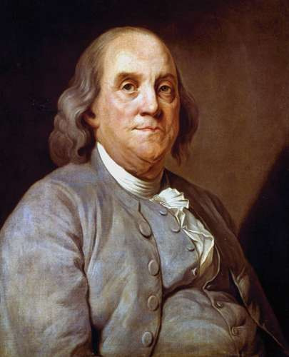
Benjamin Franklin
Boston-born Philadelphia printer, scientist, and scholar

Slide 23
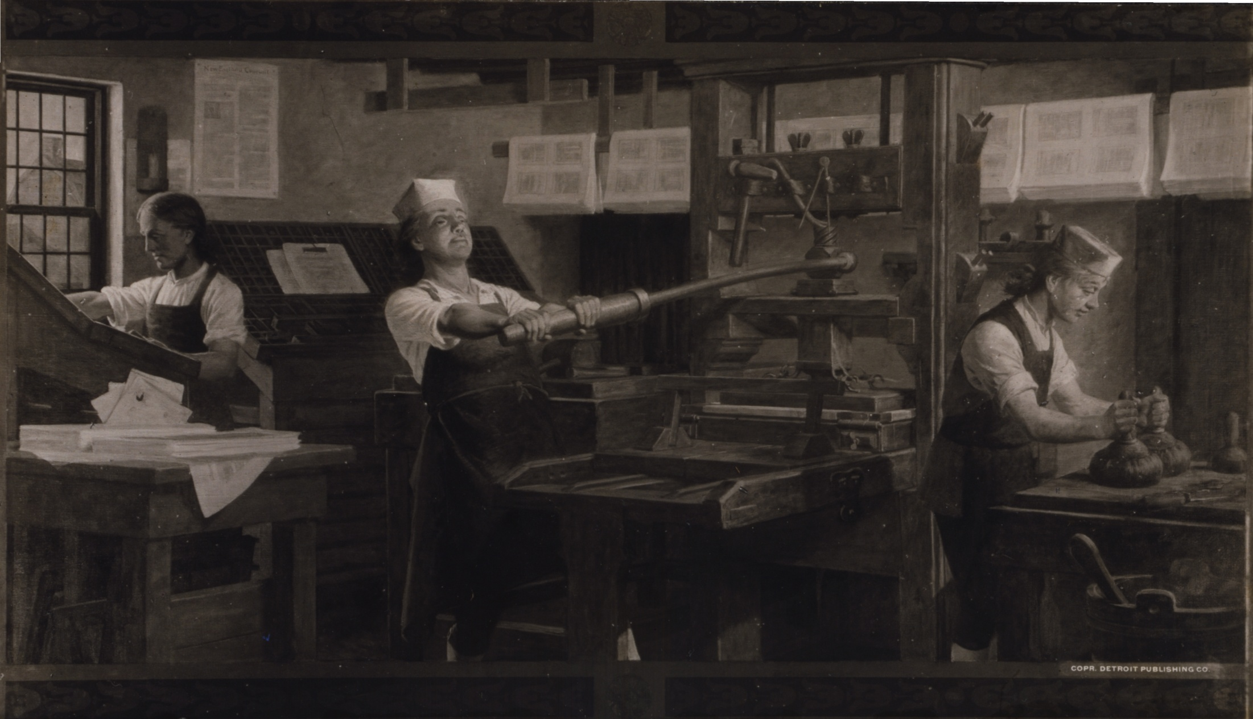
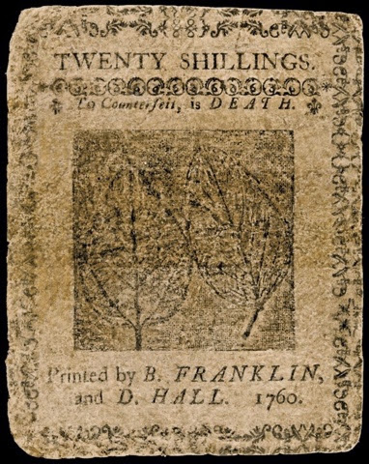

Slide 24
Early to bed, early to rise, makes a man healthy, wealthy, and wise.
A fool and his money are soon parted.
Fish and guests stink after three days.
Be slow in choosing a friend, and slower in changing.
Keep thy shop, and thy shop will keep thee.
A penny saved, is a penny earned..
A lie stand on one leg, the truth on two.
One rotten apple spoils his companion..

Slide 30
University of Pennsylvania
American Philosophical Society
Philadelphia Hospital
Library Company of Philadelphia

Slide 32
Harvard
Yale
Oxford
St. Andrews

Slide 34
Economics

Slide 35
Peter Faneuil
Boston Merchant and philanthropist
Prominent in all parts of the Triangular Trade, including the slave trade
Left money for Boston’s Faneuil Hall

Slide 36
Triangular Trade
Britain
Colonial America
Sugar,
Molasses
Rum, other trade goods
West Indies
Enslaved Africans
Africa

Slide 37
Triangular Trade
Manufactured goods
Britain
Colonial America
Tobacco, rice, fur, indigo, fish, lumber
Guns, Textiles, trade goods
Grain, Fish, Lumber
Sugar
Manufactured goods
West Indies
Africa

Slide 38
Middle Passage
The trade route that dealt with the transportation of enslaved Africans to the New World
-Approximately 12-13 million transported to the New World (perhaps as many died an the way)
- 40% to Brazil -16% to Spanish Empire
- 34% to West Indies -10% to North America

Slide 40
Mercantilism: a country's wealth is measured by the amount of gold it owns. The goal is to export more goods than you import, so that you bring more money into the country than you send out to other nations. Colonies exist to provide cheap raw materials for the mother country, and a market for the mother country’s exports.
Navigation Laws: Laws that required colonial exports to go to England, to only import English goods, in English ships.
Salutory Neglect: an unofficial British policy of non-enforcement of trade regulations on their American colonies during the 17th and 18th centuries. The purpose was to maximize economic output amongst the colonists while maintain some form of control.

Slide 41
Government

